Slide 1
Course Description and Intro
Advanced SQL for Analysts

Slide 2

Personal intro
Education
BS Math (Scientific Computing) | 2005
MS Statistics (Math dept) | 2007
MBA (specifically PMBA) | 2012
Work History
The Modellers (2007-2013) – applying statistical modling techniques against marketing problems
Domo (2013-2022) – solving business problems internally, predicting business outcomes
DESB (2018) – adjunct instructor
DESB (2022-present) – Assistant Professor
Precision Analytics (2022-present) – personal consulting practice

Slide 3
What I want to do with this class
Showcase how SQL can be used to answer business problems
Use a modern analytic-database (BigQuery)
Use advanced features you may not have covered in other courses
CTEs, arrays, window functions, non-equi joins
Write lots of queries answering (hopefully) interesting questions
Provide tips and tricks along the way
My focus is mainly on doing cool things, it’s unlikely we will have 4-hours worth of lectures every week. There will be plenty of time to talk through labs and work on projects.

Slide 4
How the course is structured
Lectures
Talk through concepts related to the lab
Discuss any problems you’re currently trying to solve
Share some tips and tricks
Labs
Problems that mirror business issues
Submit a .sql file
SQL file run against the “answer” file
Partial credit given if you get close
90% of course grade
Final Project
Project to combine concepts from the course
Will require you integrate with another product to visualize data
10% of course grade

Slide 5
Schedule of topics
Week 1
Intro Materials (today)
Week 2
CTEs
Nested data
Case statements?
Cost and optimization
Week 3
Window functions
Week 4
Non-equi joins
Cross joins
Dynamic snapshotting
Pivot functions
Week 5
Final Project
Views
Integrations
Predictive analytics (we’ll see)

Slide 6
Assumptions/pre-requisites
Assumptions
Intermediate-level SQL knowledge
Interested in learning how to use SQL to solve analytical problems
Able to think through problems and ask good questions

Slide 7
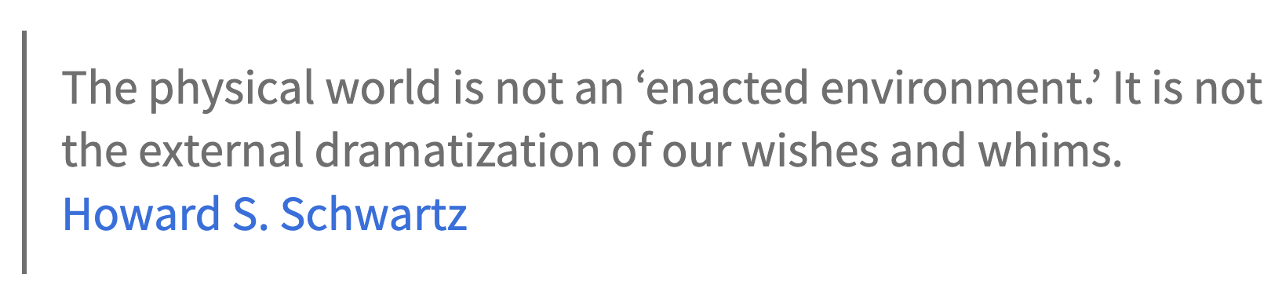
What does it mean?

Slide 8


Slide 9
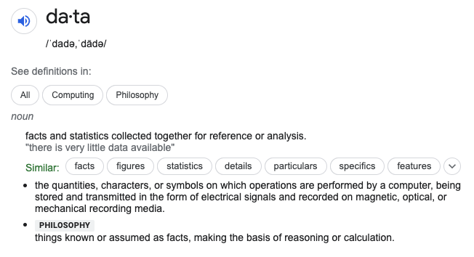
What do we need to know about data
What is data?
Think of data as a
record of an event or
a description of something

Slide 10
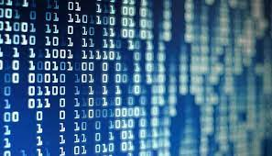
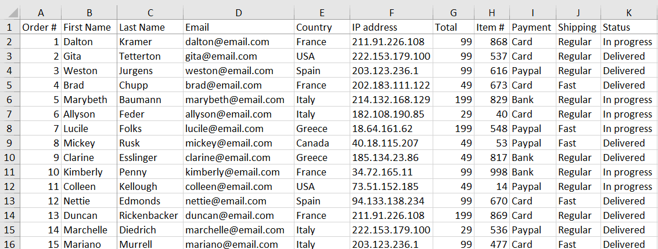

What does data look like?
Reality:
Spreadsheet is a good example.
Formatted in rows and columns
Rows represent observations or cases
Columns are the information we know about each observation
Sometimes the data isn’t stored this way in the data systems we use, but it will need to be in this format to do analysis and visualization

Slide 11
How do we get data?
Generated by the systems we use
Point of Sale
Tracking on the internet
Household appliances (IoT)
Key cards when you enter a building
Entered by people
Accounting systems
CRM
Custom apps at work
Surveys
In all cases, data acquisition is designed by people.
Make sure you are aware of the business objectives when you design the data you collect.
Many data projects end when we realize the right data wasn’t collected at the right time.

Slide 12
Different types of information
Strategic Information
Tells you the overall objectives for a business.
It’s like a map for where you are now and where you want to go
Generally, leads to a set of objectives and metrics that measure if the end state has been achieved
Tactical Information
The individual steps and actions that will deliver on the strategy
Will be a set of initiatives
Successful tactics should lead to successful strategy
Will have their own measurements of success
Operational Information
Day-to-day activities
Very low level
Things at an operational level are typically either done or not done
Meaning, metrics will typically be percentages of actions completed

Slide 13
What is a database
General definition: A database is a collection of structured data that is stored and organized in a way that allows for efficient retrieval and manipulation of that data.
History lesson:
1960s: Hierarchical and network models – these models used a tree-like structure to organize data and were used primarily in large mainframe environments.
1970s: Relational model was introduced by Edgar F. Codd of IBM
1980s: Object-oriented databases were introduced – designed to handle complex data types and relationships more efficiently than relational databases.
1990s: New database models were developed due to challenges posed by the internet, including NoSQL databases, which are designed to handle unstructured and semi-structured data.
2000s: Analytic databases, in-memory databases, and graph databases were developed.

Slide 14
What is a database
General definition: A database is a collection of structured data that is stored and organized in a way that allows for efficient retrieval and manipulation of that data.
History lesson:
1960s: Hierarchical and network models – these models used a tree-like structure to organize data and were used primarily in large mainframe environments.
1970s: Relational model was introduced by Edgar F. Codd of IBM
1980s: Object-oriented databases were introduced – designed to handle complex data types and relationships more efficiently than relational databases.
1990s: New database models were developed due to challenges posed by the internet, including NoSQL databases, which are designed to handle unstructured and semi-structured data.
2000s: Analytic databases, in-memory databases, and graph databases were developed.

Slide 15



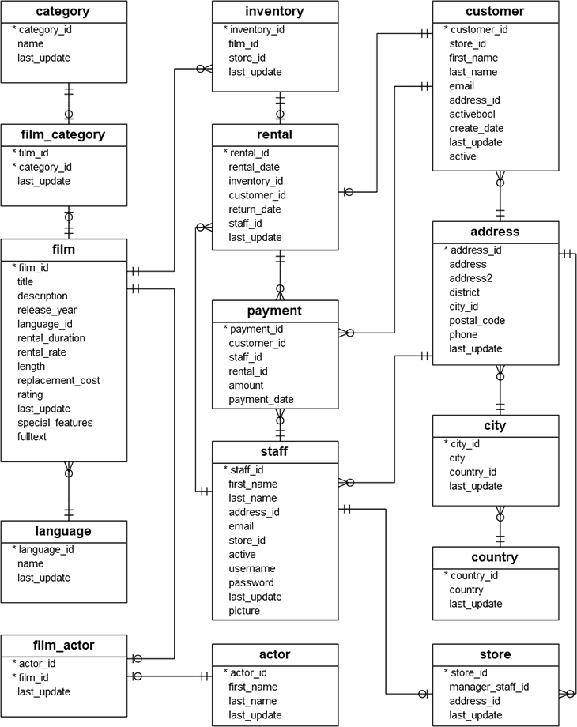

Relational databases
Relational databases are optimized for handling structured data with complex relationships.
A relational database will typically be used to manage and store transactions.
They can efficiently store, manage and query large amounts of structured data.
Relational databases do really well when you need low latency and frequent table updates.

Slide 16




Analytical databases
Analytical databases are optimized for storing and querying large data sets.
Use SQL-like queries. In many cases, the SQL used for an analytical database will be nearly identical to the SQL used for relational databases.
Will add certain functionality like the ability to store data in arrays.
Often available via REST API. Queries optimized for runtime and will cache results so queries can be returned quickly.
Not good at handling transactions or making small updates to records. Better for BI, analytics and dashboards.

Slide 17
Why use bigquery?
Cloud-based product with a strong educational program
Has SQL features shared by other analytic databases
Gaining in popularity
Focused on performing analytics
We’ll leave the table structure optimization to our friends in IT
Gaining in popularity and very similar to Snowflake which is also gaining in popularity

Slide 18
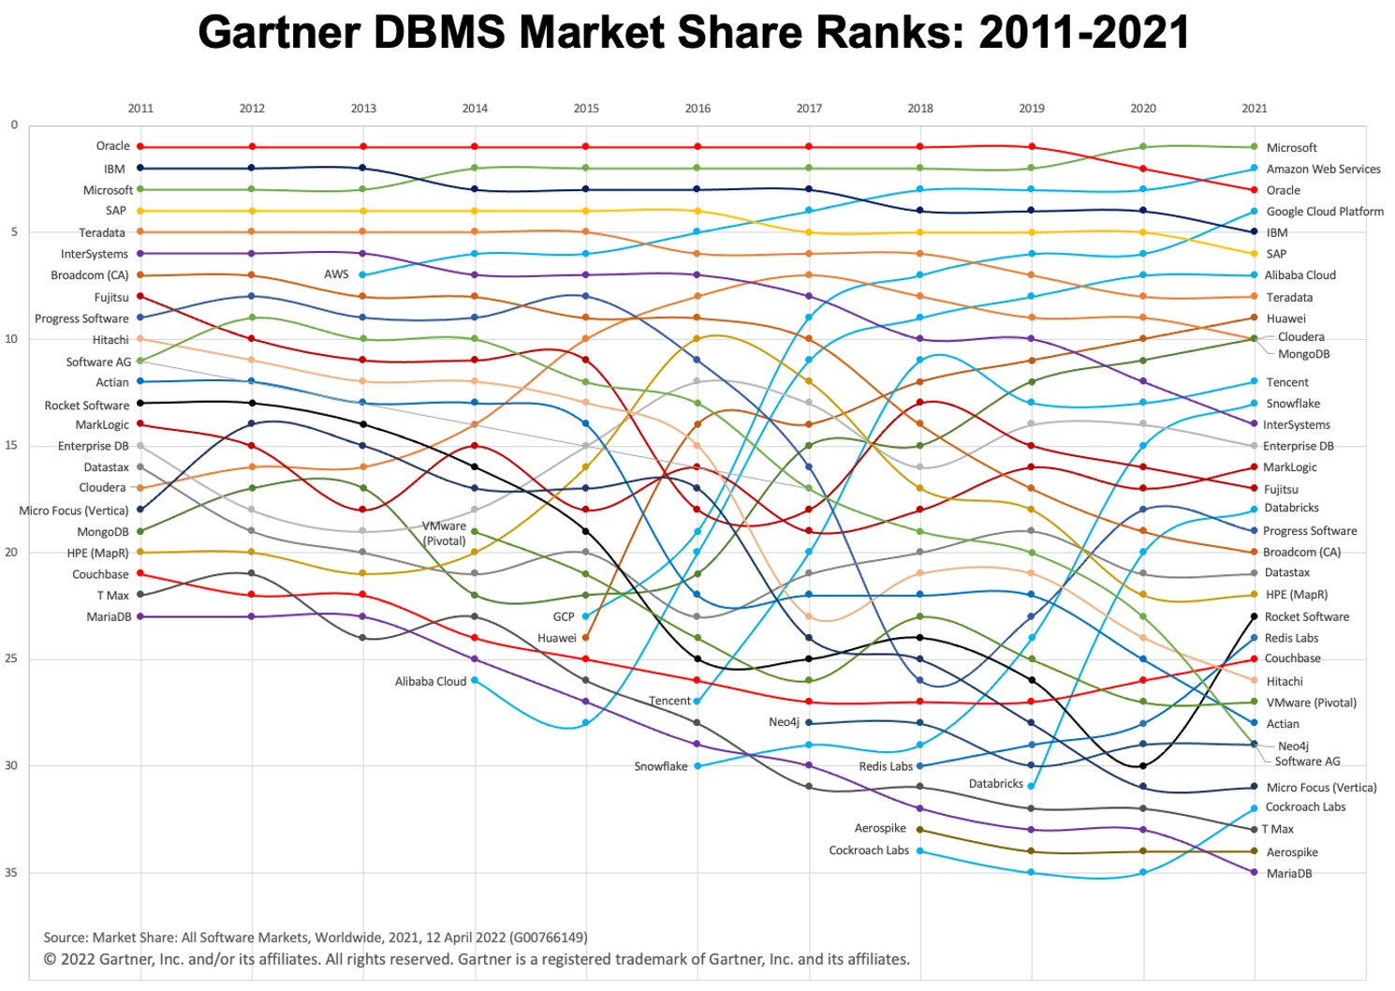

Slide 19
Let’s go to lab 1 and get started
Create an account
Get access to the semester’s tables
Create saas db tables
Talk about estimating costs a little
Look at submitting results

Slide 20


